Slide 1
Plasma waves, spectra, and interferometry
D. B. Graham

Slide 2
Electromagnetic waves
Assume a plane electromagnetic wave:
From Faraday’s equation we obtain
Likewise from we obtain
Therefore, B₁ is always perpendicular to k and E₁.

Slide 3
Whistler waves
Whistler waves electromagnetic waves between f_{LH} and f_{ce}.
Whistlers are circularly polarized (right handed).
Despun spacecraft coordinates
Field-aligned coordinates (z || B₀)
Hodogram of perp. fields

Slide 4
Minimum variance analysis
MVA can be applied to whistler waves.
Since , min. variance direction is || k.
v_{min} = [0.86, -0.13, -0.48]
v_{int} = [0.38, -0.45, 0.81]
v_{max} = [0.33, 0.88, 0.34]
b₀ = B₀/|B₀| = [-0.91, 0.14, 0.39]
λ_{max}/λ_{int} = 1.03
λ_{int}/λ_{min} = 35.5
Wave normal angle is then
Whistler waves propagate along B₀.

Slide 5
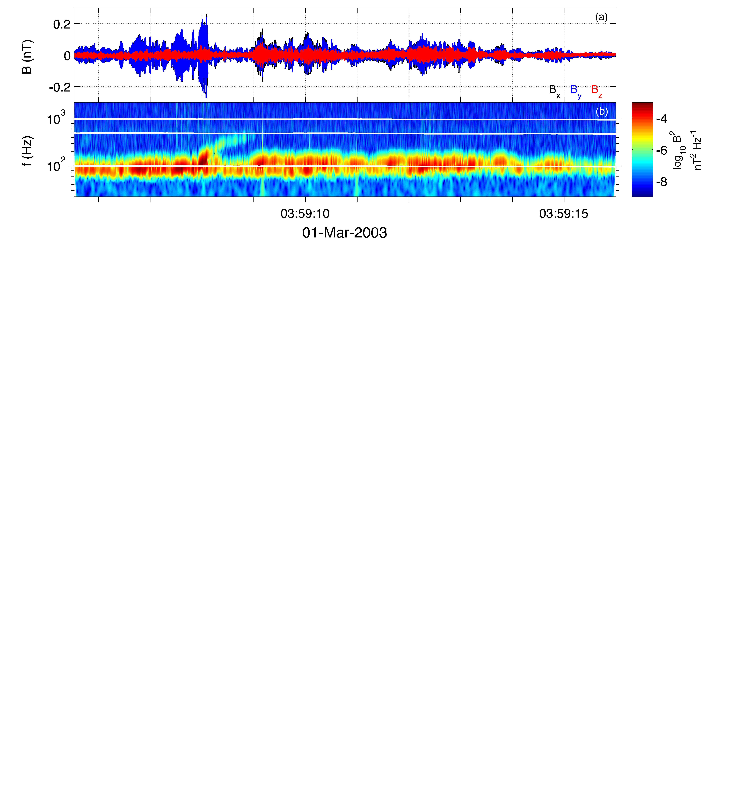
Spectral Analysis
Often observed waves do not have a single frequency (or wave number).
Important to know how wave properties change with frequency, as well as time.
Therefore, spectral analyses are used.
Time series of B.
Wavelet spectrogram of B.

Slide 6
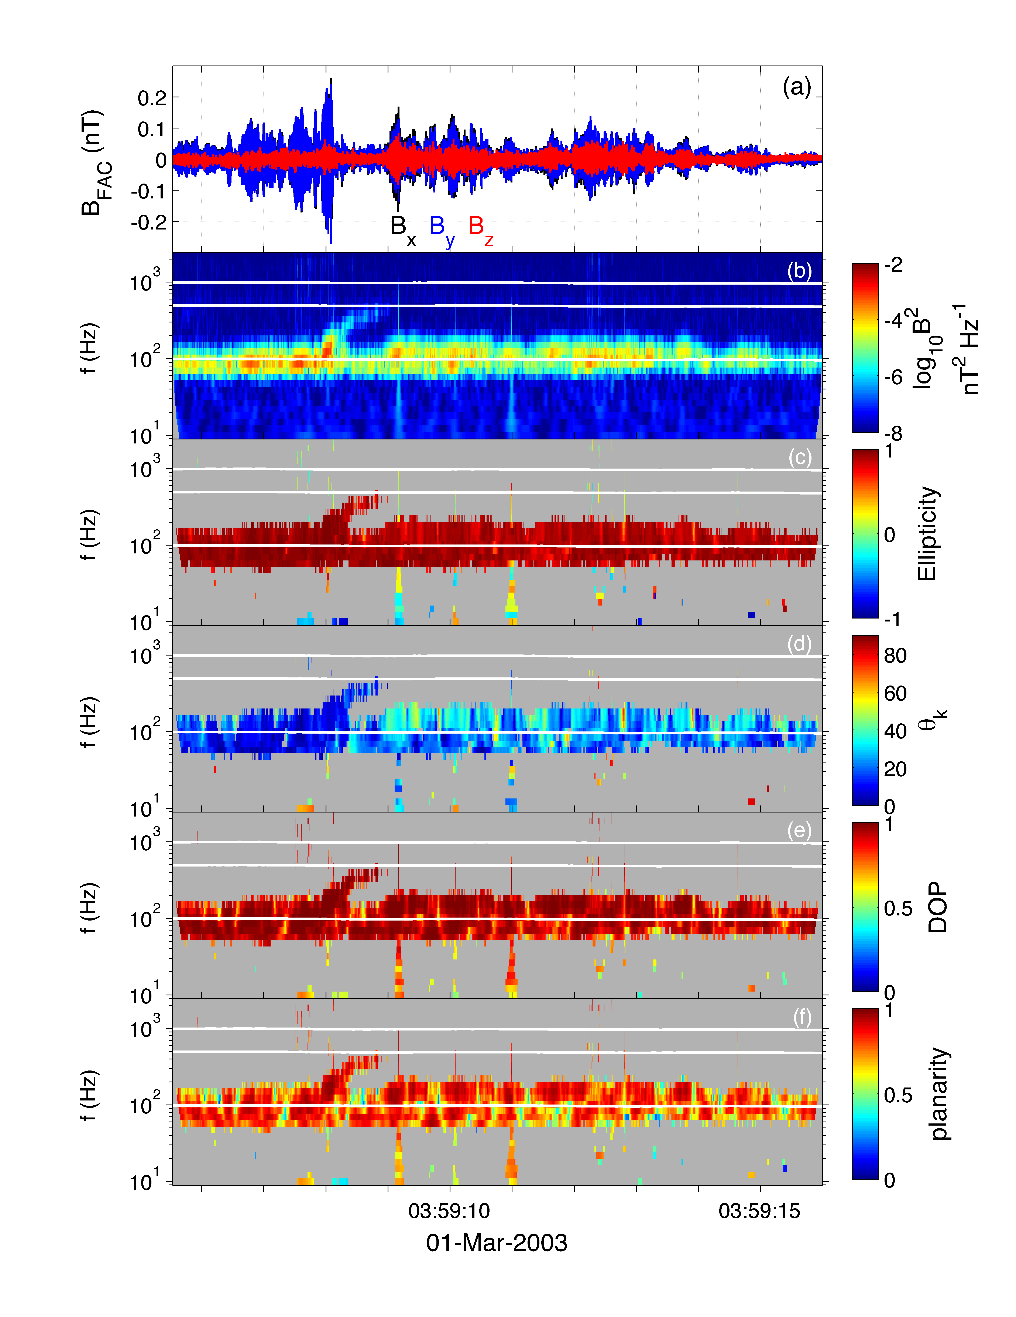
Polarization properties
Spectral analysis techniques can be used to calculate polarization and propagation properties.
From 3D magnetic field: Ellipticity, degree of polarization, wave-normal angle, planarity.
3D magnetic and electric field are used to calculate the Poynting vector.
[Santolik, et al., JGR, 2003]
NB: Cluster only measures E in spin plane. E.B = 0 must be used to estimate Poynting vector.

Slide 8
Electrostatic Waves and Interferometry
Often electrostatic waves are observed: Electrostatic solitary waves, Langmuir waves, ion-acoustic waves, &c.
Different analysis techniques are required; no magnetic field fluctuations.
We investigate electrostatic waves with E₁ || B₀.
To characterize these waves requires spatially separated measurements of E₁.
Electrostatic waves
ESWs

Slide 9
Interferometry
Typically, electric is calculated from probe combinations p1-p2 and p3-p4.
When individual probe potentials are available, electric fields can be constructed from different probe combinations.
For electrostatic waves we want two E measurements along B₀.

Slide 10
Interferometry
We can construct two E measurements closely aligned with B.
V_{sc} = (V₁+V₂)/2
E₃ = -(V₃-V_{sc})/44m, E₄ = -(V_{sc}-V₄)/44m.
Spacecraft rotation limits the allowable time intervals.
C2 – 2004 March 03
22:40:29.85 UT
E3 and E4 measurements are separated by 44m.

Slide 11
Wave speeds
Wave speeds can be calculated from the time delays between fields.
Time difference between fields is 0.34 ms.
Cross-spectral analysis can be used to calculate f-k power spectrum.
Power follows a linear dispersion relation:

